Slide 1
Predicting Real Estate Valuation in New Taipei City, Taiwan
Sesha Jonnavithula

Slide 2
Description of the Problem
Taiwan is a “country” that thrives on foreign investments on its industries
These foreign investments increase foreign involvement in Taiwan and therefore make it increasingly difficult for Chinese annexation politically
An important consideration for foreign investors is the predicted value of their investments
This algorithm will predict prices of real estate properties in New Taipei City, Taiwan

Slide 3
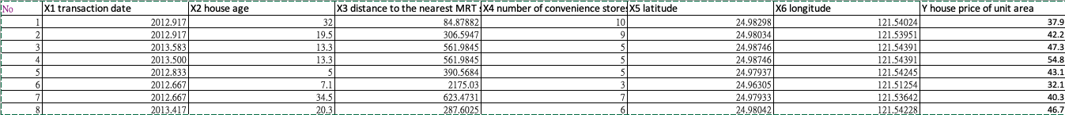
Data Description
Transaction Date
House Age
Distance to Nearest MRT Station
Number of Convenience Store
Latitude
Longitude

Slide 4
Algorithms Model
Linear
h(x) = w₀ + w₁x₁ + w₂x₂+ w₃x₃+ w₄x₄+ w₅x₅+ w₆x₆
Quadratic
h(x) = w₀ + w₁x₁ + w₁x²₁ + w₂x₂+ w₂x²₂+ w₃x₃+ w₃x²₃+ w₄x₄+ w₄x²₄+ w₅x₅+ w₅x²₅+ w₆x₆+ w₆x²₆
These are the hypothesis functions that will allow me to predict the prices given all input variables. These input variables are x₁ through x₂.

Slide 5
Training, Validation, Testing Methods
Use a five fold train-test technique
Test J errors for each fold in linear
Test J errors for each fold in quadratic
Average J term errors for test and train sets in both quadratic and linear models
Find best model to use
Find best weights in the best model from the five folds

Slide 6
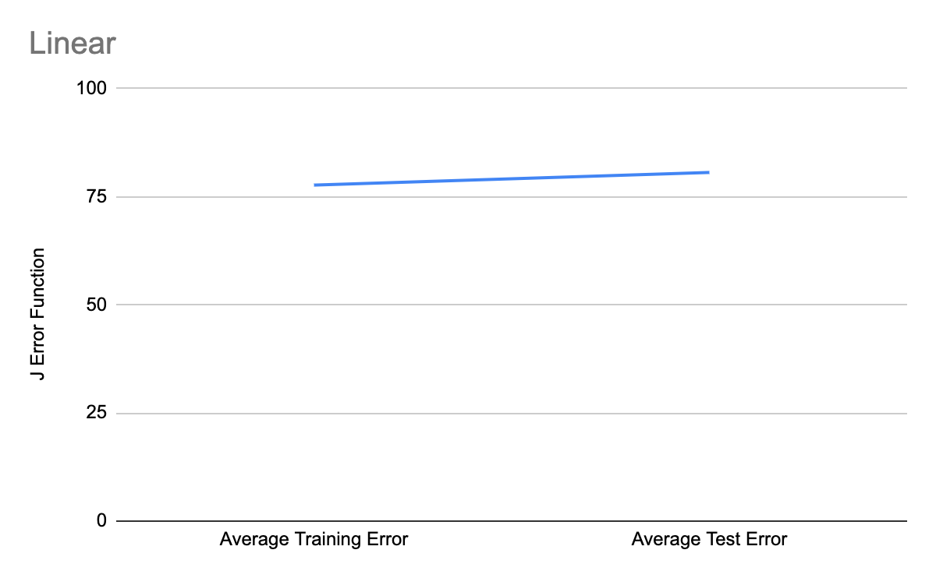
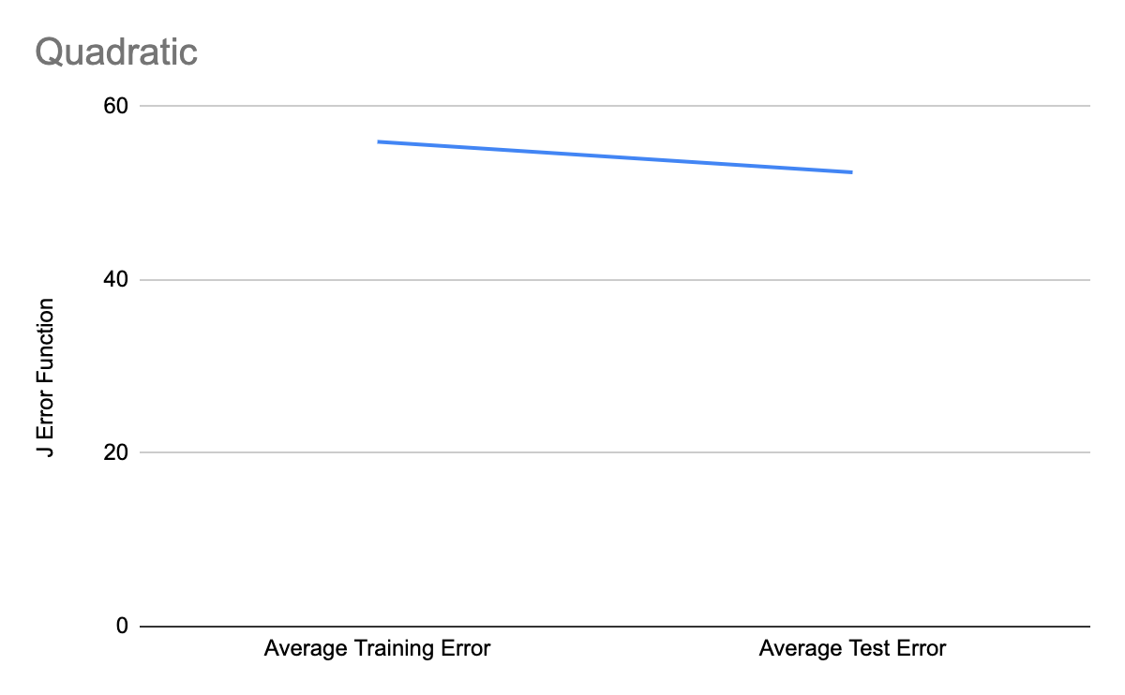
Evaluation of Your Results
Final Best Weights
[ 2.19769838e-04]
[ 2.22302056e-01]
[ 7.82839081e-04]
[-8.20274189e-01]
[ 1.31489939e-02]
[-1.20593851e-02]
[ 1.37711217e-06]
[ 2.08887215e-01]
[ 5.31021153e-02]
[ 8.67647203e-02]
[ 4.19612743e+00]
[ 1.16320129e-02]
[-4.18832642e-01]
K-Fold | Linear Fit | Quadratic Fit
1234 | 83.36492305 | 56.76734665
5 | 57.27046493 | 53.7430328
1235 | 66.54039037 | 59.63005309
4 | 124.9850583 | 33.62955147
1245 | 82.36666742 | 59.16770018
3 | 62.33349759 | 42.42697156
1345 | 78.77941508 | 53.80854382
2 | 76.33987941 | 65.46337029
2345 | 77.45559194 | 50.34206859
1 | 82.18189953 | 66.80535663
Average Training Error | 77.70139757 | 55.94314247
Average Test Error | 80.62215995 | 52.41365655
The determined lowest error was from the second fold weights from the quadratic fit.

